Slide 1

CRACKING HASHES USING HASHCAT

Slide 2
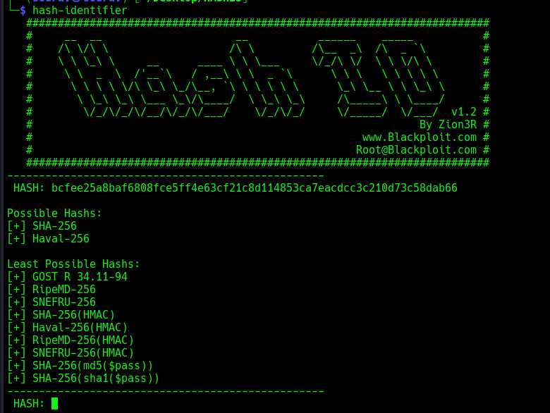

STEP 1
Using hash-identifier to check for possible hash-types. If the possible ones don’t work , do checkout the least possible ones as well.
STEP 2

Slide 3
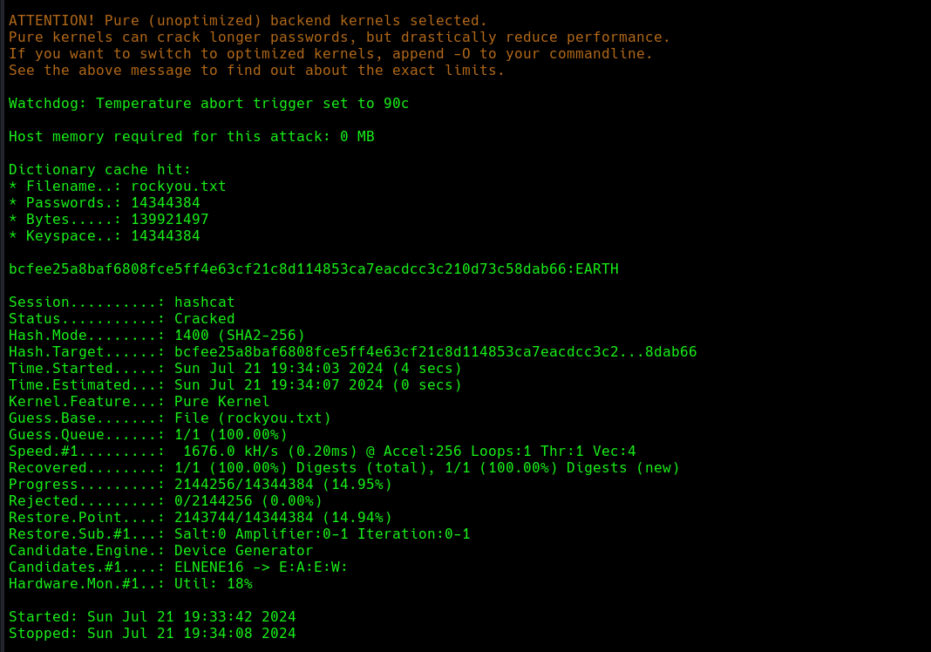
STEP 3
The hash has been cracked and the password is EARTH. We has cracked the hash using the SHA2-256 Algorithm and the rockyou.txt wordlist

